Slide 1
Using ALDEx2 to analyze high-throughput sequencing datasets
Greg Gloor
U. Western Ontario
Department of Biochemistry
ggloor@uwo.ca : @gbgloor

Slide 2

The goal
Given a set of data for two or more groups derived from high throughput sequencing, what are the univariate differences between the groups?
Ideally concurrent with multivariate approaches
Samples can be RNA-seq, 16S rRNA genes (microbiome), ChIP-seq, SELEX, …
Features can be gene sets, OTU sequences, genomic regions, allele abundances …
Notes:
Many more fragments than we can count

Slide 3
Where does data come from?
We start with random DNA or RNA fragments from environment
We take a random sample and make a library
A random sample of the library is sequenced and mapped to genomes
This generates a table of counts per feature in each sample
Very sparse data
Asymmetric
may have 0 values in one group but not the other – these have information
Notes:
Many more fragments than we can count

Slide 4
Sequencing makes sausage
Gloor et al Front. Micro. 2017

Slide 5
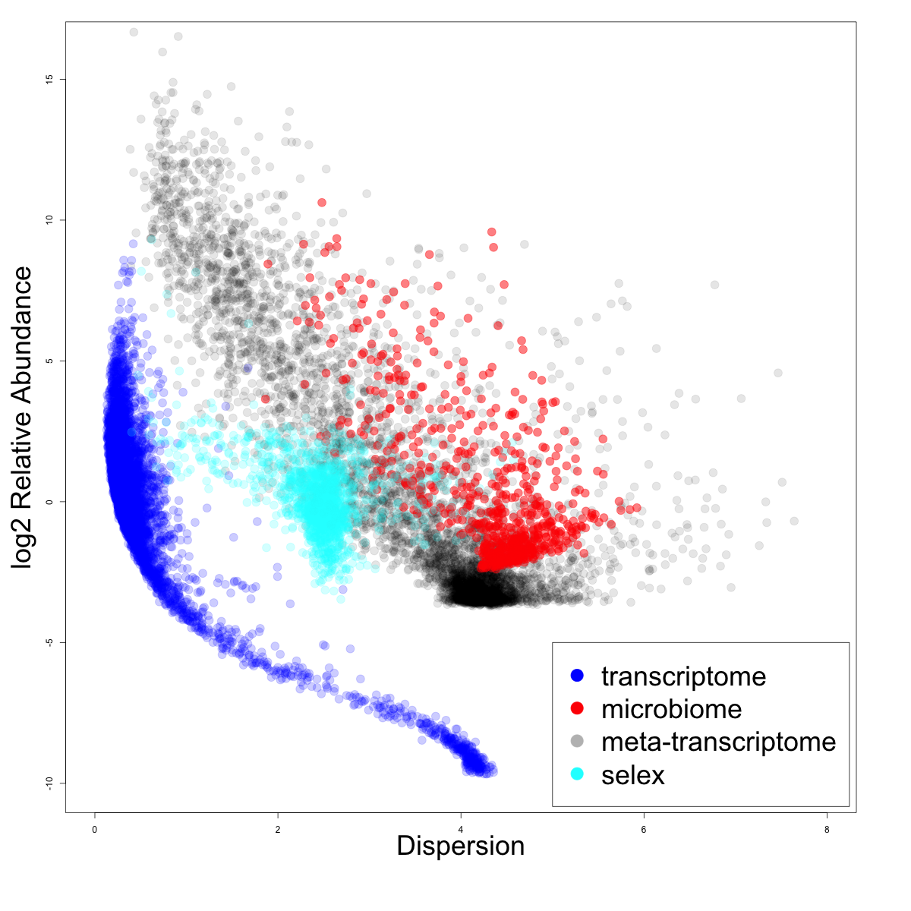
Dispersion v. rAbundance
high variance datasets
microbiome
low variance datasets
RNA-seq

Slide 6
We have problems
Sequencing data are probabilistic random samples
Almost always point estimates or worse – averages
Sequencing data are compositions
everything correlates with everything
the levels are confounded if the bacterial load (or the total amount of mRNA) differs between samples
our conclusions change when we include or exclude different sets of features
(Pearson 1896 Proceedings of the Royal Society of London 60, 489: Aitchison 1986 The Statistical Analysis of Compositional Data: Lovell 2015 PLoS Comput Bio,11:e1004075 )
Sequencing data are high-dimensional
Therefore statistical analyses can be wildly optimistic
Sequencing data are sparse
Therefore we need to estimate many of our values
Most of us are unaware (begrudgingly aware) of the problems

Slide 7
ALDEx2 does and does not
Does not
Estimate parameters
Assume distributions
Pool data across features
Subset the data
Correct for sequencing depth
Does
Estimate probability distributions directly from data
Include a maximally uninformative prior distribution
Account for measurement error
Manipulate probabilities using rules and tools of CoDa
Report the mean ensemble value by default

Slide 8
Data as counts
Example 100 random sample sets
range=1800-2200
range= 8000-12000
range=450-550
🐯
🐞
👽
Gloor et al Front. Micro. 2017

Slide 9
As delivered by sequencing
Constant sum of 1000
Constant sum operations:
Count normalization
Rarefaction
Proportion
percentage, relative abundance
Sequencing
Simplex: one fewer dimensions than variables
Problems remain regardless of dimension
Gloor et al Front. Micro. 2017

Slide 10
Normalization is no help at all
Once data are on the simplex, they cannot be removed easily

Slide 11
Log-ratios for CoDa
Count
Sequencing
Simplex
27
853
66
740
112
216
clr(x) = [ log(x₁/g_{X}), log(x₂/g_{X}), … log(x_{D}/g_{X}) ]
X = [ x₁, x₂, … x_{D} ], g_{X} = geometric mean of X
Aitchison 1986. Stat. Anal. Comp Data
Pawlowsky-Glahn, 2015. Mod. Anal. CoDa
Notes:
Scale dependence - hence ‘normalization’
Correlation and covariation are unreliable
Addition and subtraction are not useful operations
Subsetting and aggregating are problematic
Sparse data is an issue

Slide 12
Real sequence data are variable
Same features from same samples from the same library
Sequenced on different lanes
We should get comparable answers
We can estimate the variability by sampling Dirichlet instances
Multivariate, constrained balls in an urn
Fernandes, PLoS ONE 2013
Gloor, Aus J. Stat. 2016

Slide 13
Think of the 0s!
0 count can be real – or a non-detect
0 count is not 0 probability to detect the count
p_{i} = 0 is strong, invalid, assumption
[P_{i} > 0, P_{i} →0]
Fernandes, PLoS ONE 2013
Gloor, Aus J. Stat. 2016
EBI Hinxton

Slide 14
ALDEx2: probabilistic CoDa
Group 1 Group 2
Generate posterior estimates of the data consistent with the observed data and the chosen prior(s)
Dirichlet instances
clr transform instances
Calculate test values on each instance
Correct for FDR
Report the expected value of each test for all instances
Dramatically reduces false positives with little or no loss of sensitivity for essentially any seq*omics dataset
Fernandes, et al. 2013. PLoS ONE
Fernandes, et al. 2014. Microbiome
Thorsen, Microbiome 2016
Notes:
Many more fragments than we can count

Slide 15
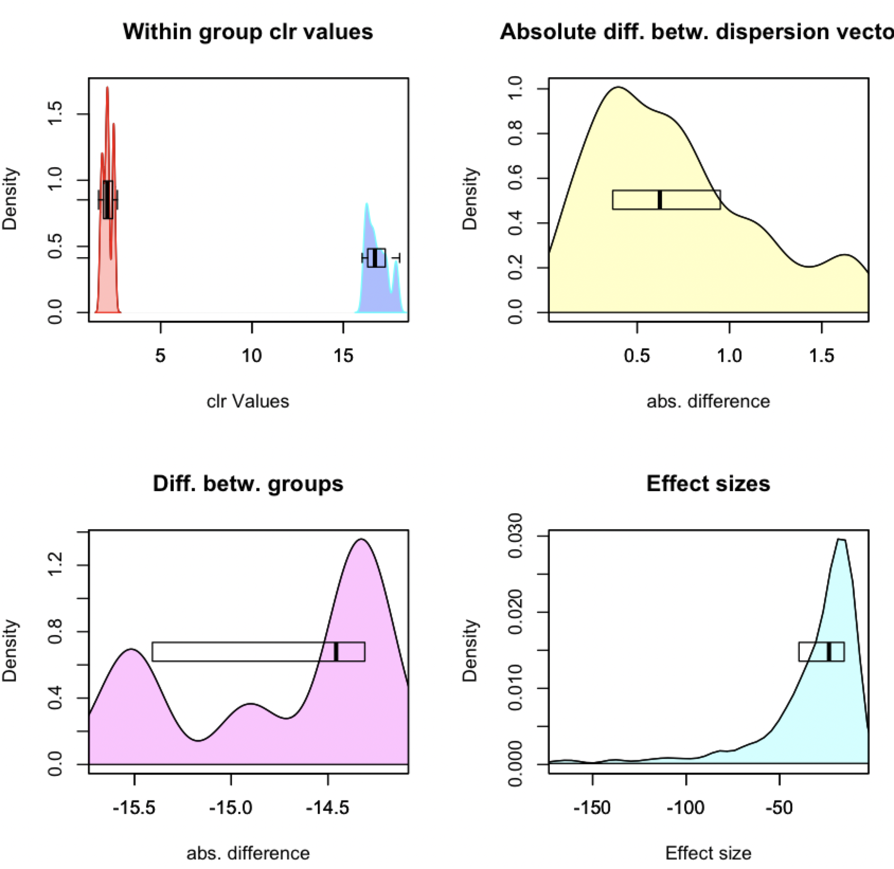
ALDEx2 under the hood
CLR Distribution
Dispersion
aldex.plotFeature()
Difference
Effect

Slide 16
Meta-transcriptomics of an ecosystem
Difficult datasets
Sequencing all the mRNA in a collection of bacteria
Information about what is being made now
Often unbalanced
Different conditions can have different taxonomic compositions
Both absolute and relative abundance of the taxa and their transcripts can change
Relative abundance does not necessarily reflect environmental reality in sequencing data

Slide 17
Test dataset - bacterial vaginosis
Marked asymmetry in bacterial composition
H is predominantly Lactobacillus sp.
BV is mixed bag of anaerobes with L. iners
Marked asymmetry in functional composition
Asymmetrically sparse functions
Asymmetrically expressed functions
Group genes to functional level (SEED, KEGG, InterPro, etc)
If everything is different, then nothing is important
We must assume something is invariant

Slide 18
Functionalize
Macklaim & Gloor 2018. From RNA-seq to Biological Inference: Using Compositional Data Analysis in Meta-Transcriptomics. Meth. Mol. Bio.
Gloor, Macklaim, Fernandes, 2016. Displaying Variation in Large Datasets: Plotting a Visual Summary of Effect Sizes. J. of Comp. and Graph. Statistics

Slide 19
BV dataset with conventional tool
Bland-Altmann Plot
Each function is a point
Red are ‘DE’
Obviously unbalanced dataset
What assumptions do not fit?
Majority invariant?
Dispersion ~ abundance?
Notes:
Breaks the assumptions
Note the midpoint of the dataset is off the 0 line

Slide 20
Need to center the data
All
One
Robust midpoint variance
Low variance, high abundance
Median

Slide 21
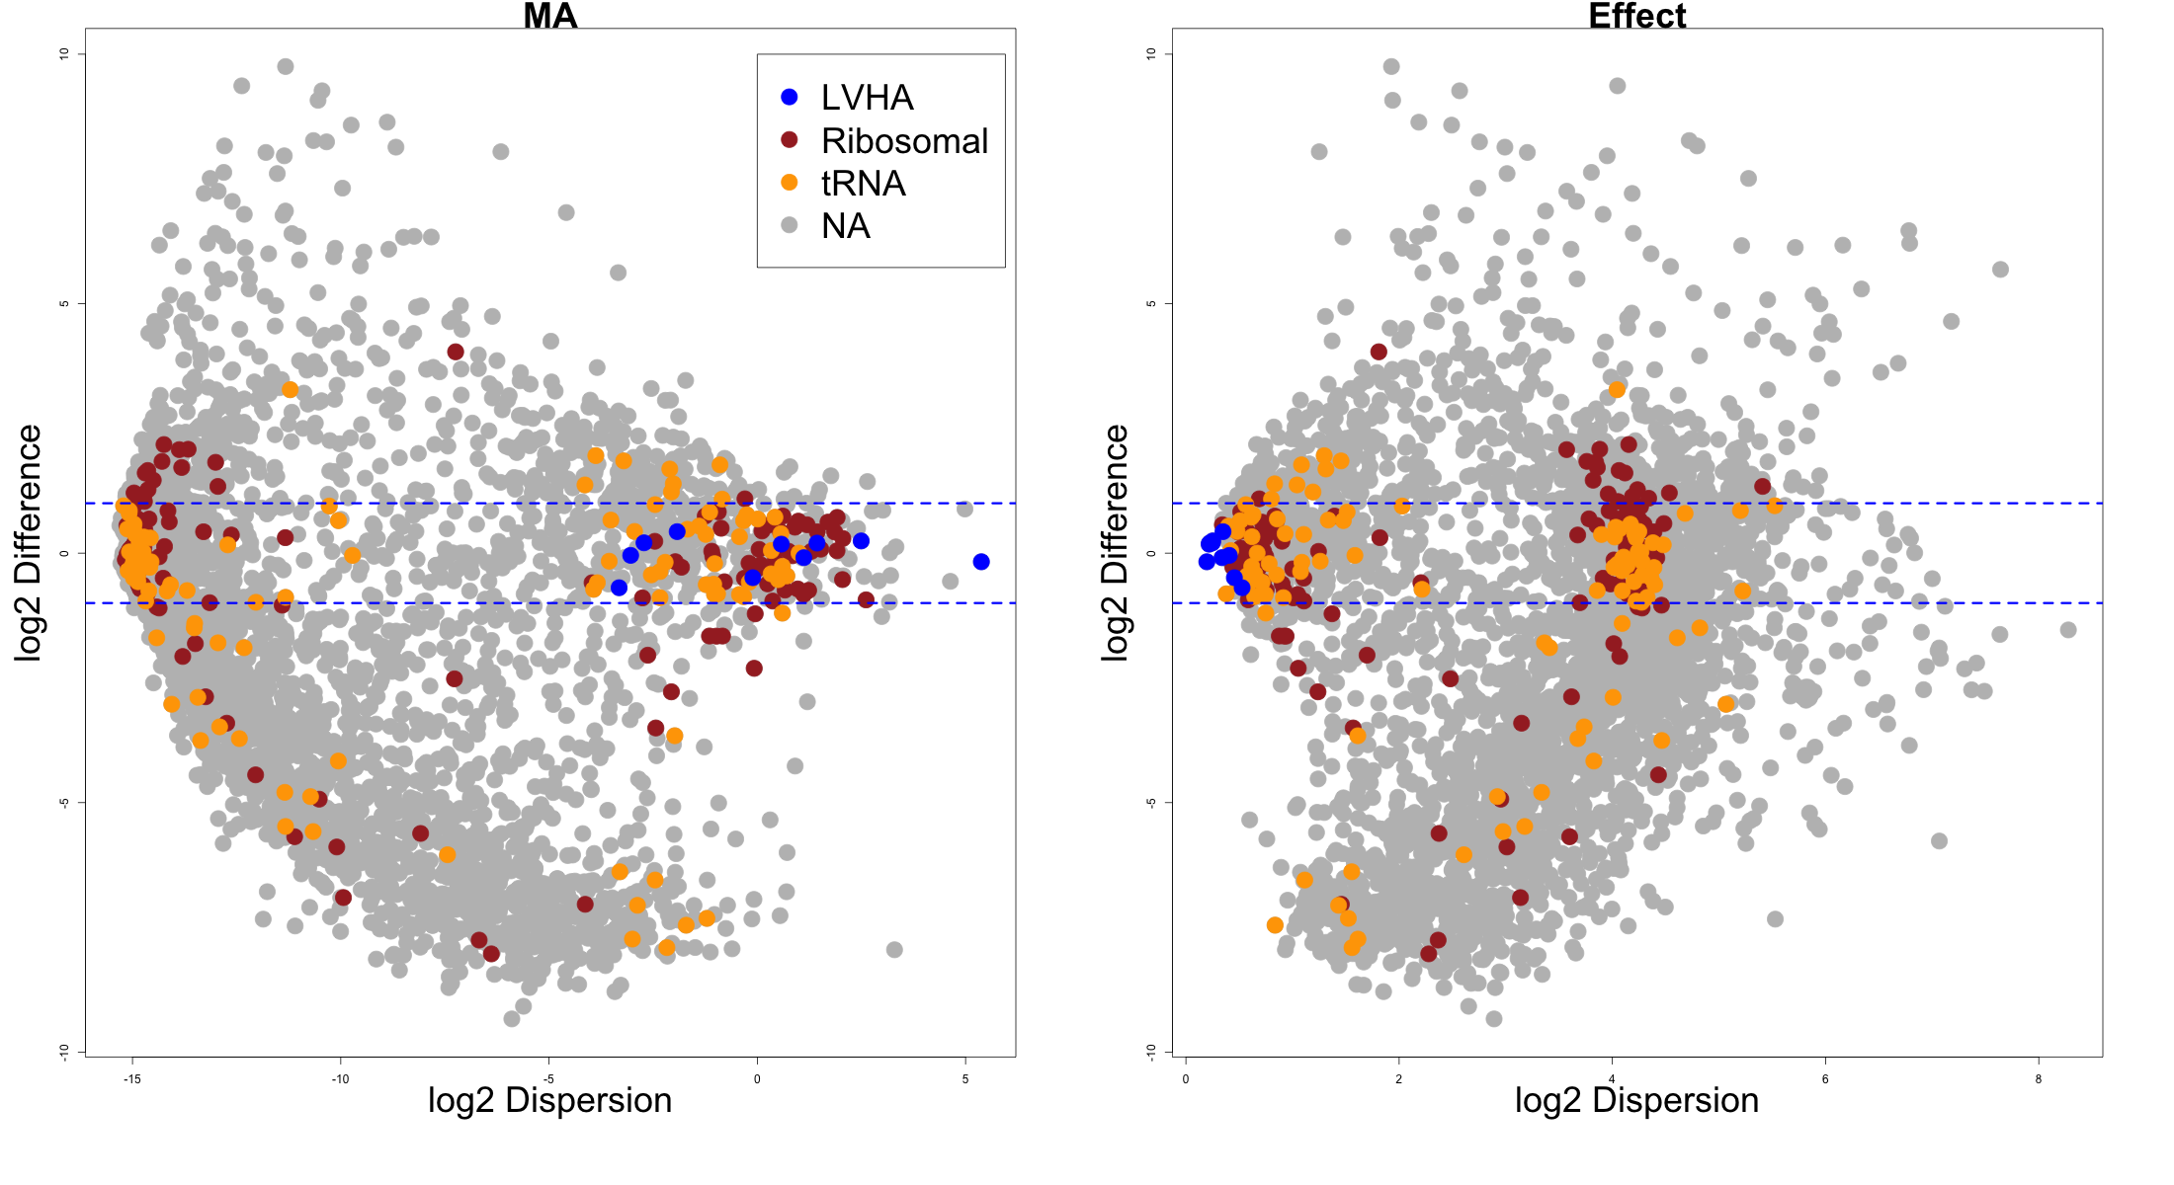
Housekeeping genes centred

Slide 22
Functions
Denom
Cell division protein MraZ
D-tyrosyl-tRNA(Tyr) deacylase
Deoxyuridine 5'-triphosphate nucleotidohydrolase (EC 3.6.1.23)
DNA ligase (EC 6.5.1.2)
FIGfam135315: Iojap-related protein
LSU ribosomal protein L3p (L3e)
Membrane-associated zinc metalloprotease
Peptide chain release factor 3
Ribosomal large subunit pseudouridine synthase B (EC 4.2.1.70)
Signal peptidase I (EC 3.4.21.89)
Transcription-repair coupling factor
Translation elongation factor Ts
tRNA nucleotidyltransferase (EC 2.7.7.21) (EC 2.7.7.25)
Tryptophanyl-tRNA synthetase (EC 6.1.1.2)
Motility/chemotaxis functions

Slide 23
Summary
Macklaim, Macmillan unpublished
Macmillan Sic Rep 2015

Slide 24
BV Distinguishing features

Slide 25
BV gene level

Slide 26
A combined analysis
Original dataset
Vaginal swab – treatment naïve (S)
Vaginal wash – BV treatment naïve, H post-metronidazole
Deng et al. mSphere 2018
Annotate reads using same pipeline
Diamond/SEED
Keep functions shared by both

Slide 27
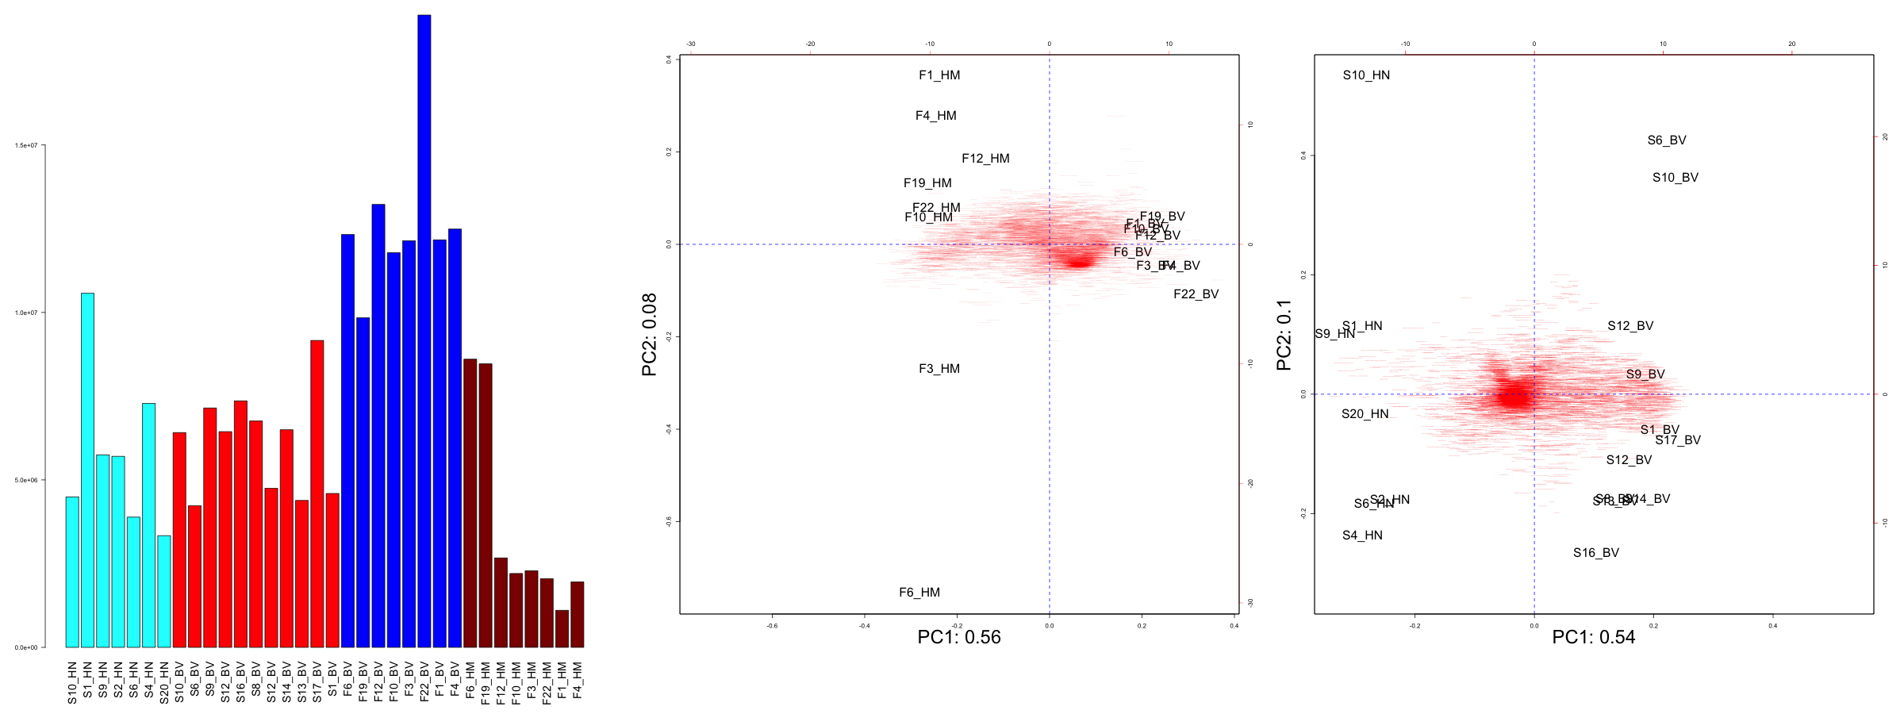
Data characteristics
Fluid samples
Swab samples
Deng et al. mSphere 2018
Maclaim Meth. Mol.. Biol 2018

Slide 28
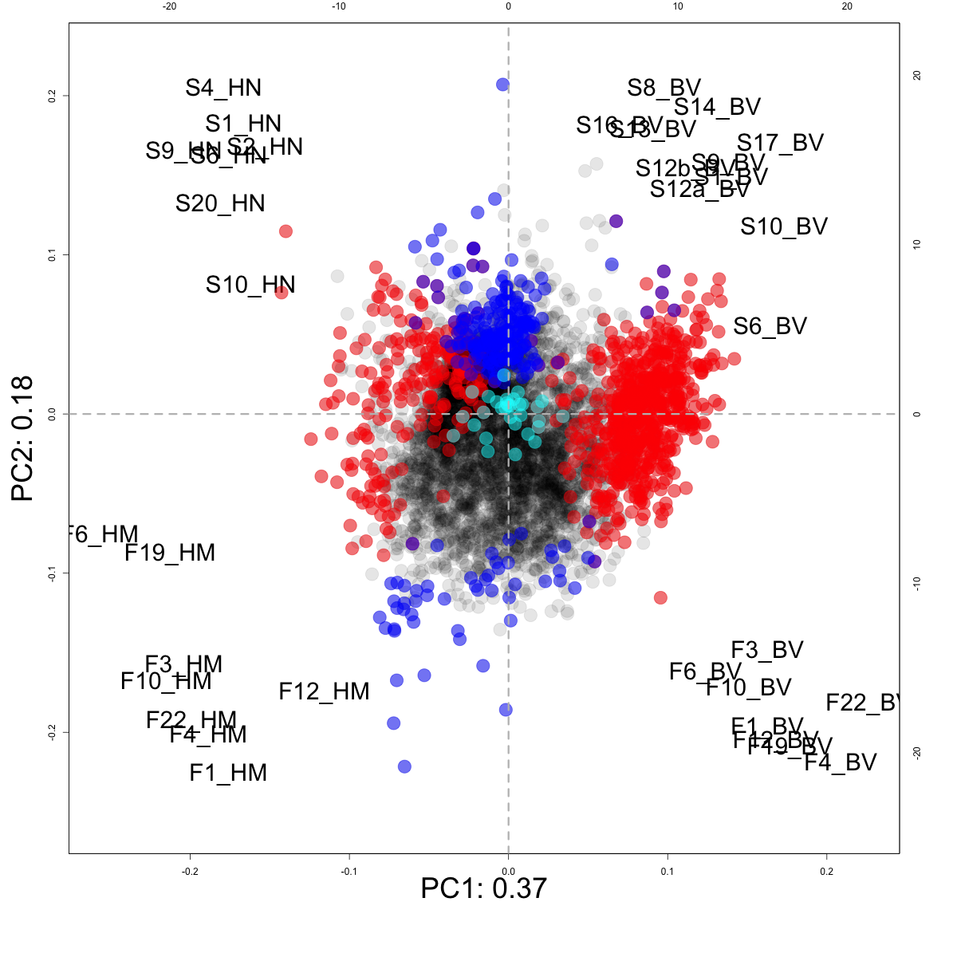
Distinct datasets: ALDEx2 E(glm)
Not different
LVHA
S vs F
H vs BV

Slide 29
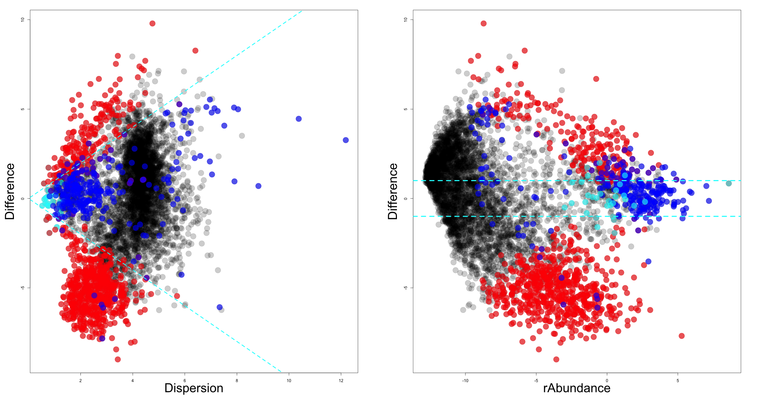
Effect
Not different
LVHA
S vs F
H vs BV

Slide 30
Conclusions
ALDEx2 makes a probabilistic distribution of the data
Only assumption is random sampling
Manipulates the probability distributions using rules and tools of CoDa
Fully general method
Meta-transcriptomes are hard
Can at least get reproducible answers across datasets
Asymmetry in datasets is surprisingly common
Proper centering is needed to prevent non-sensical answers

Slide 31

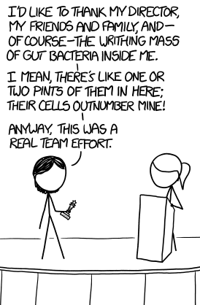


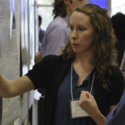




Andrew
Fernandes
Jean
Macklaim
Vera Pawlowsky-Glahn
Juan Jose Egozcue
Justin Silverman
philr
Tom Quinn
propr
Gregor Reid
Jeremy Burton
Daniel Giguere

